Slide 1

TEAM MEMBERS:
AKKASSIN ASSEL
BOLEKBAYEVA ANEL
AKHANOVA BAKDINA
YUSSUPOVA ARAILYM

Slide 2

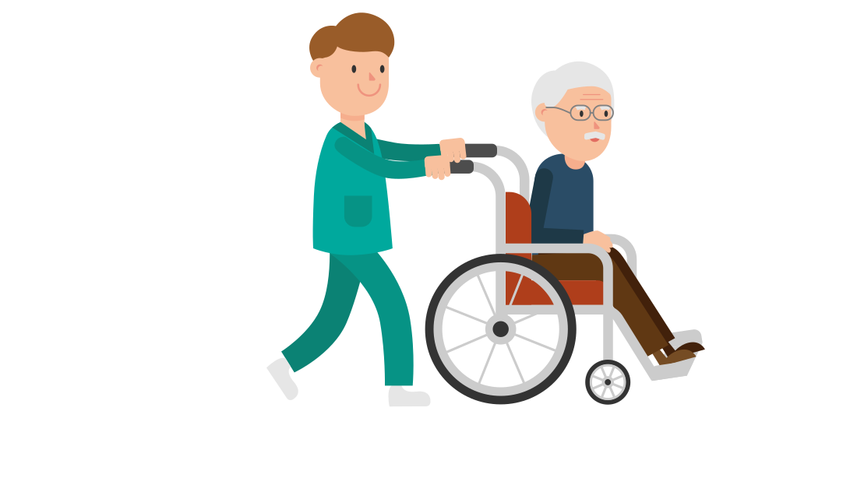
Realization of a special wheelchair
for people with disabilities

Slide 3

1.Discussion 2.Equipment order 3.Project assembly 4.Writing source code 5.Error handling

Slide 4


Status: Done
4. Divided our responsibilities
3. What we need to do in this project, what we should buy
2. Realize a special wheelchair for people with
disabilities using Smart Technologies
1. Decided to implement technology to help people around the world

Slide 5

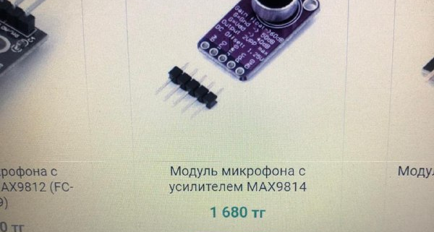
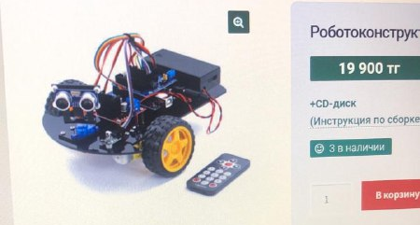
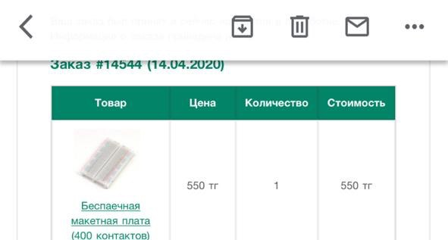
We ordered all equipment that we need for our project.

Slide 6
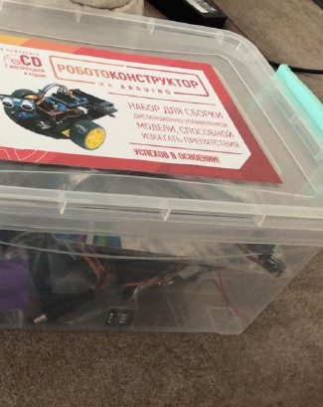
STATUS: IN PROCESS
Received our equipment and started assembling wheels, chair of project

Slide 7
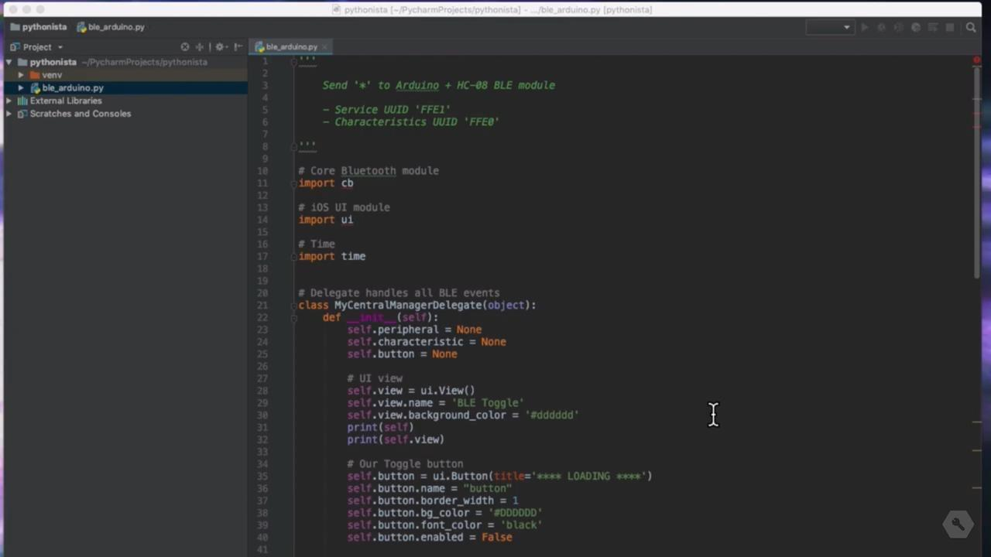
WRITING SOURCE CODE: IN PROCESS
STARTED WRITING SOUCE CODE FOR APPLICATION BY WHICH WE CAN MANAGE OUR WHEELCHAIR
ANELYA’S SCREEN

Slide 8
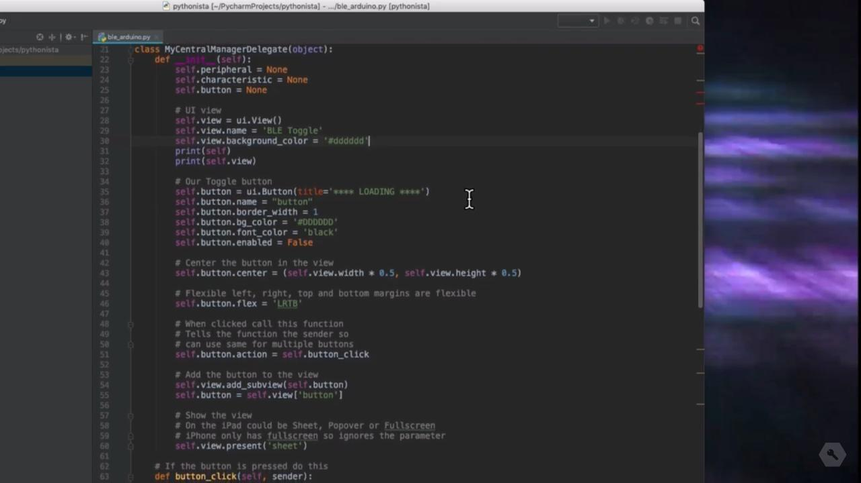

Slide 9
ERROR HANDLING: IN PROCESS

